Slide 1
📊Title: AI/ML Capstone for Paul Dunn
For the ideation stage
1 Problem Statement
What problem are you trying to solve?
What larger issues do the problem address?
Outcomes/Predictions
What prediction(s) did you make?
Identify applicable predictor (X) and/or target (y) variables.
Data Acquisition
Where are you sourcing your data from?
What is the dimension? Any missing values?
1
2
3
Variable | Value
Data Source | Meteostat
Rows # | 284 rows × 7 columns
Columns # | 1.) forecast 3-5, 2.) spatial forecast values plus digital terrain model.
Numerical Cols # | All
Missing Values Present # | TBD
Outliers?# | TBD
Can I train a model to forecast mean surface temperature, precipitation and other metrological variables using spatial methods that include elevation and aspect of sample sites?
1.) Terrain influence on meteorological variables is discernable from available data using elevation and aspect alone.
2.) Spatial prediction can be modeled in 4D.
Data Preparation
What data preparation do you plan to do before modeling?
Modeling
Which models would you be trying out?
Model Evaluation
How would you evaluate your model’s performance? Results?
4
5
6
1.) Time series decomposition: Mtemp is seasonal, whereas prcp and wspd may be defined as partially cyclical.
2.) EBK Regression Prediction local to sites (spatially) by aspect and elevation.
3.) Variations between 3 climates should be observable.
Limited elements of missing values. TBD
1.) Residuals should be stationary wrt overall time window. Residue s/b lass than prediction error (MAE/RMSE)
2.) Methods to be disclosed ASAP (ArcGIS ArcPy site package temporarily unavailable.)

Slide 2
📊Title: AI/ML Capstone 1
1 Problem Statement
What problem are you trying to solve?
What larger issues do the problem address?
Outcomes/Predictions
What prediction(s) did you make?
Identify applicable predictor (X) and/or target (y) variables.
Data Acquisition
Where are you sourcing your data from?
What is the dimension? Any missing values?
1
2
3
Q: Can I train a model to forecast long-term mean surface temperature, precipitation and other metrological variables with satisfactory decomposition.
A: Yes, for temperature and precipitation. However, additional research to manage drought in predictive models is required.
Marine, Montane and Continental climates adhered to anticipated seasonal variation, but decomposition was difficult and prediction data tended to skew downward.
Due to limited number of sample sites, EBK Linear Regression was not feasible. Used EBK 3D.
Variable | Value
Data Source | Meteostat
Rows # | 284 rows × 7 columns (sample)
Columns # | 1.) forecast 3 (focus for spatial analysis on prcp only (1)
Numerical Cols # | All
Missing Values Present # | 1.) Removed from data set 2.) N/A
Outliers?# | N/A (removed in preprocessing)
Data Preparation
What data preparation was done before the modeling?
Modeling
Which models were used for the prediction purpose?
Model Evaluation
How did you evaluate your model’s performance? Results?
4
5
6
Removed NULL data to reduce modeling issues. Time series data as called for 20 year periods.
1.) Classical statistics: Time series decomposition and forecasting.
2.) Geostatistics: Empirical Bayesian Kriging 3D (‘sliced’ by elevation in UI)
1.) Reasonable results were achieved for temperature and precipitation.
2.) EBK LR requires larger dataset. The 4 raster DEMs selected contain hundreds of pixels at a 10M resolution. Many more sample sites required to use this model, or perhaps resampling of the image resolution to 2-300M

Slide 3
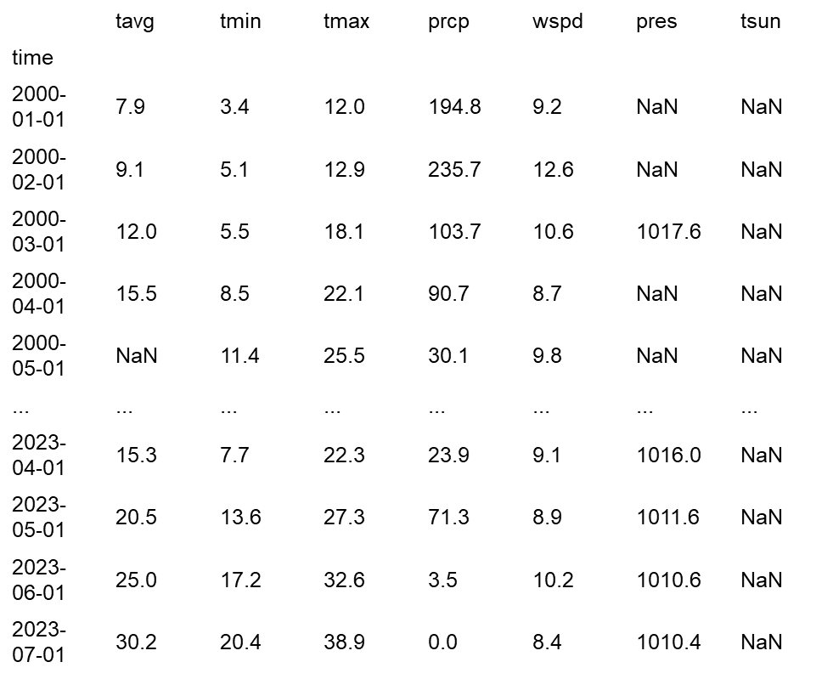
Resources: Data

Slide 4
Resources: Methods
pip install meteostat --upgrade pip
from datetime import datetime
import matplotlib.pyplot as plt
from meteostat import Point, Monthly
import pandas as pd
start = datetime(2000, 1, 1)
end = datetime(2023, 12, 31)
site = Point(40.65067617, -122.3220844, 202.96428)

Slide 5
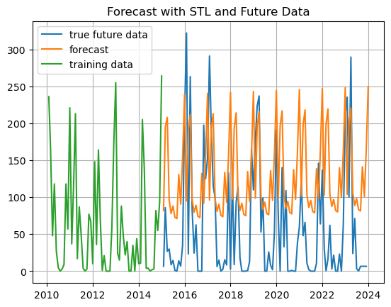

Slide 6
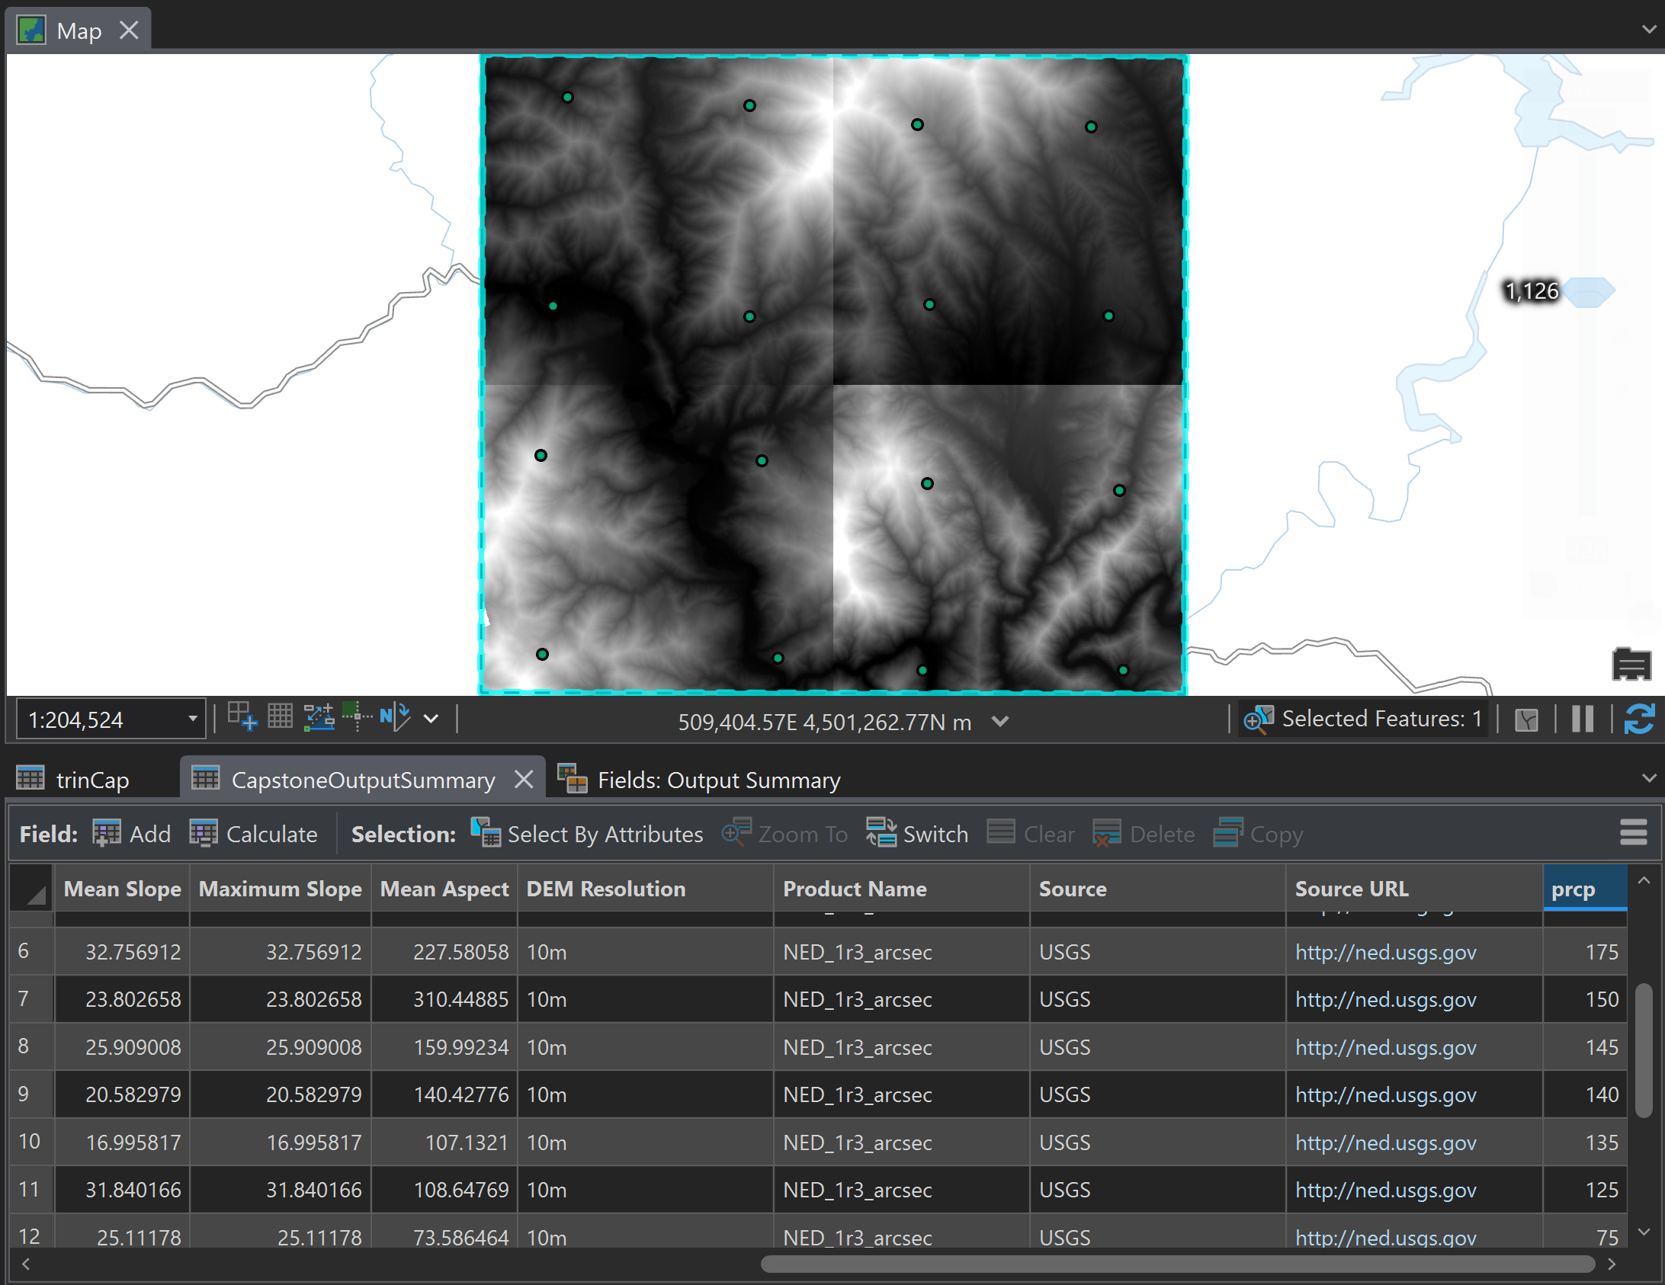

Slide 7
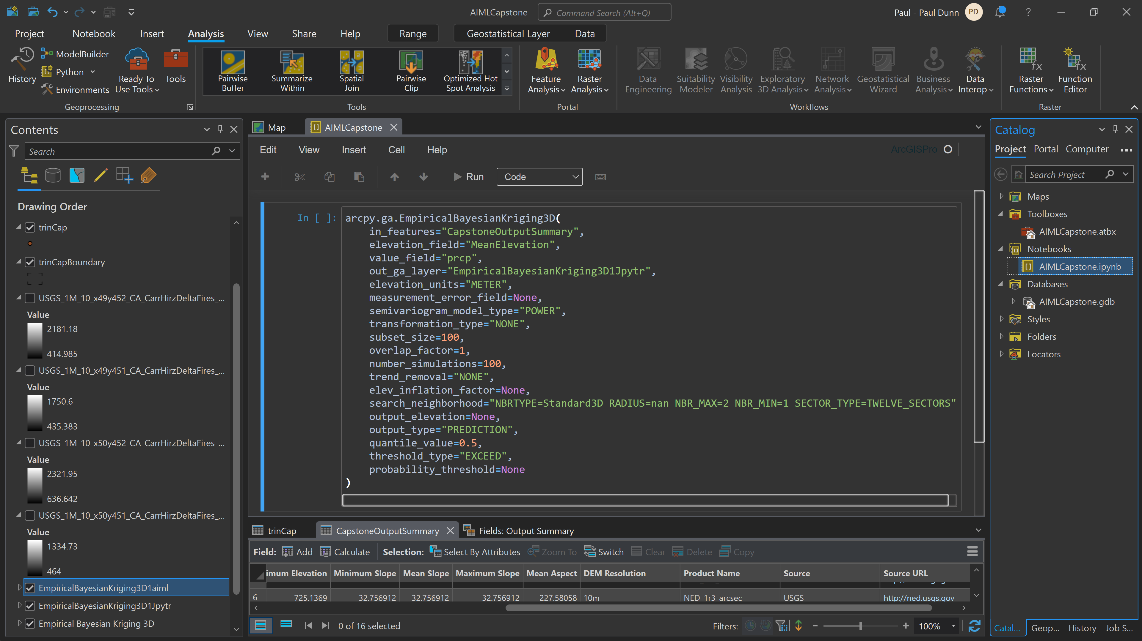

Slide 8
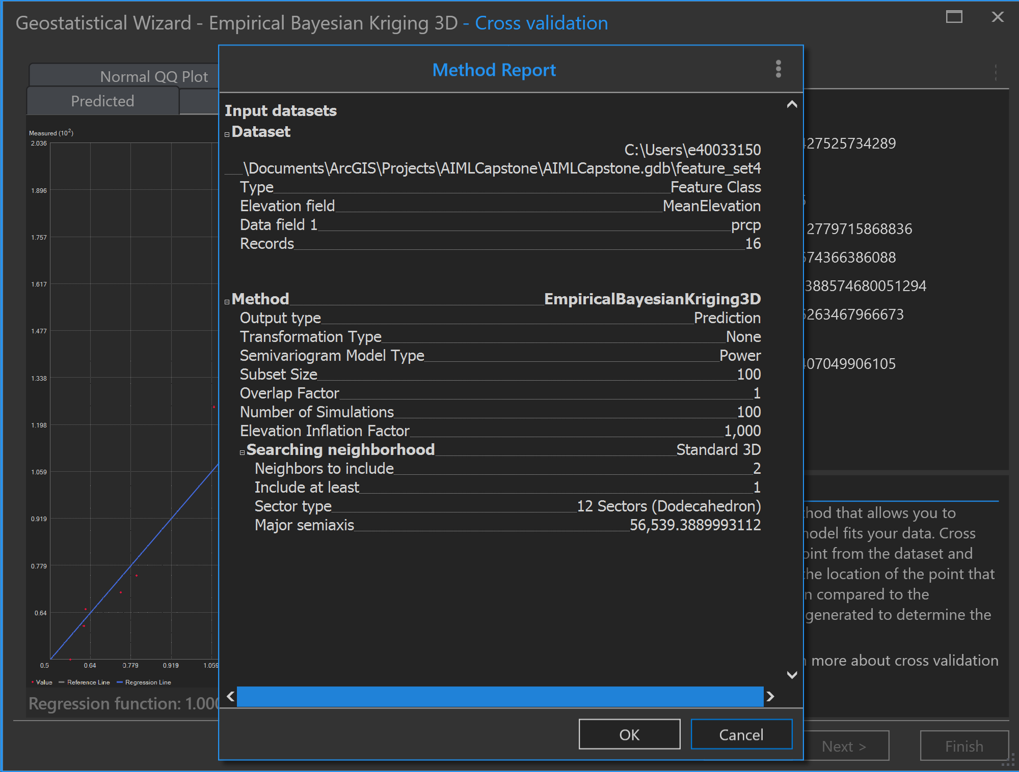

Slide 9
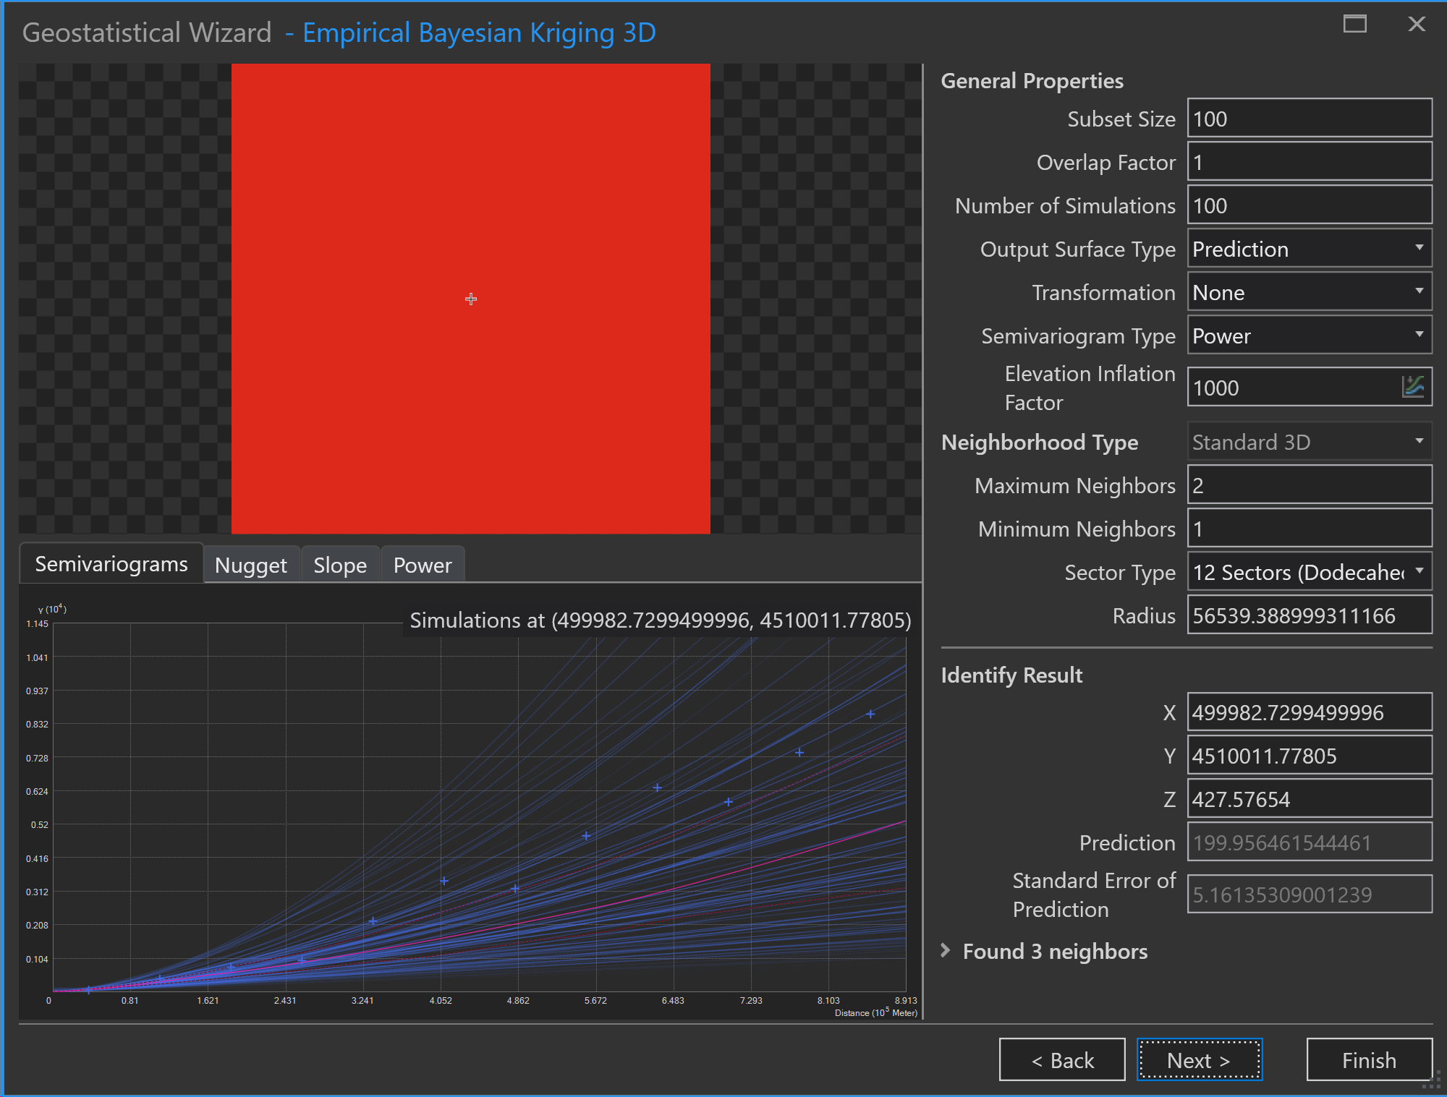

Slide 10
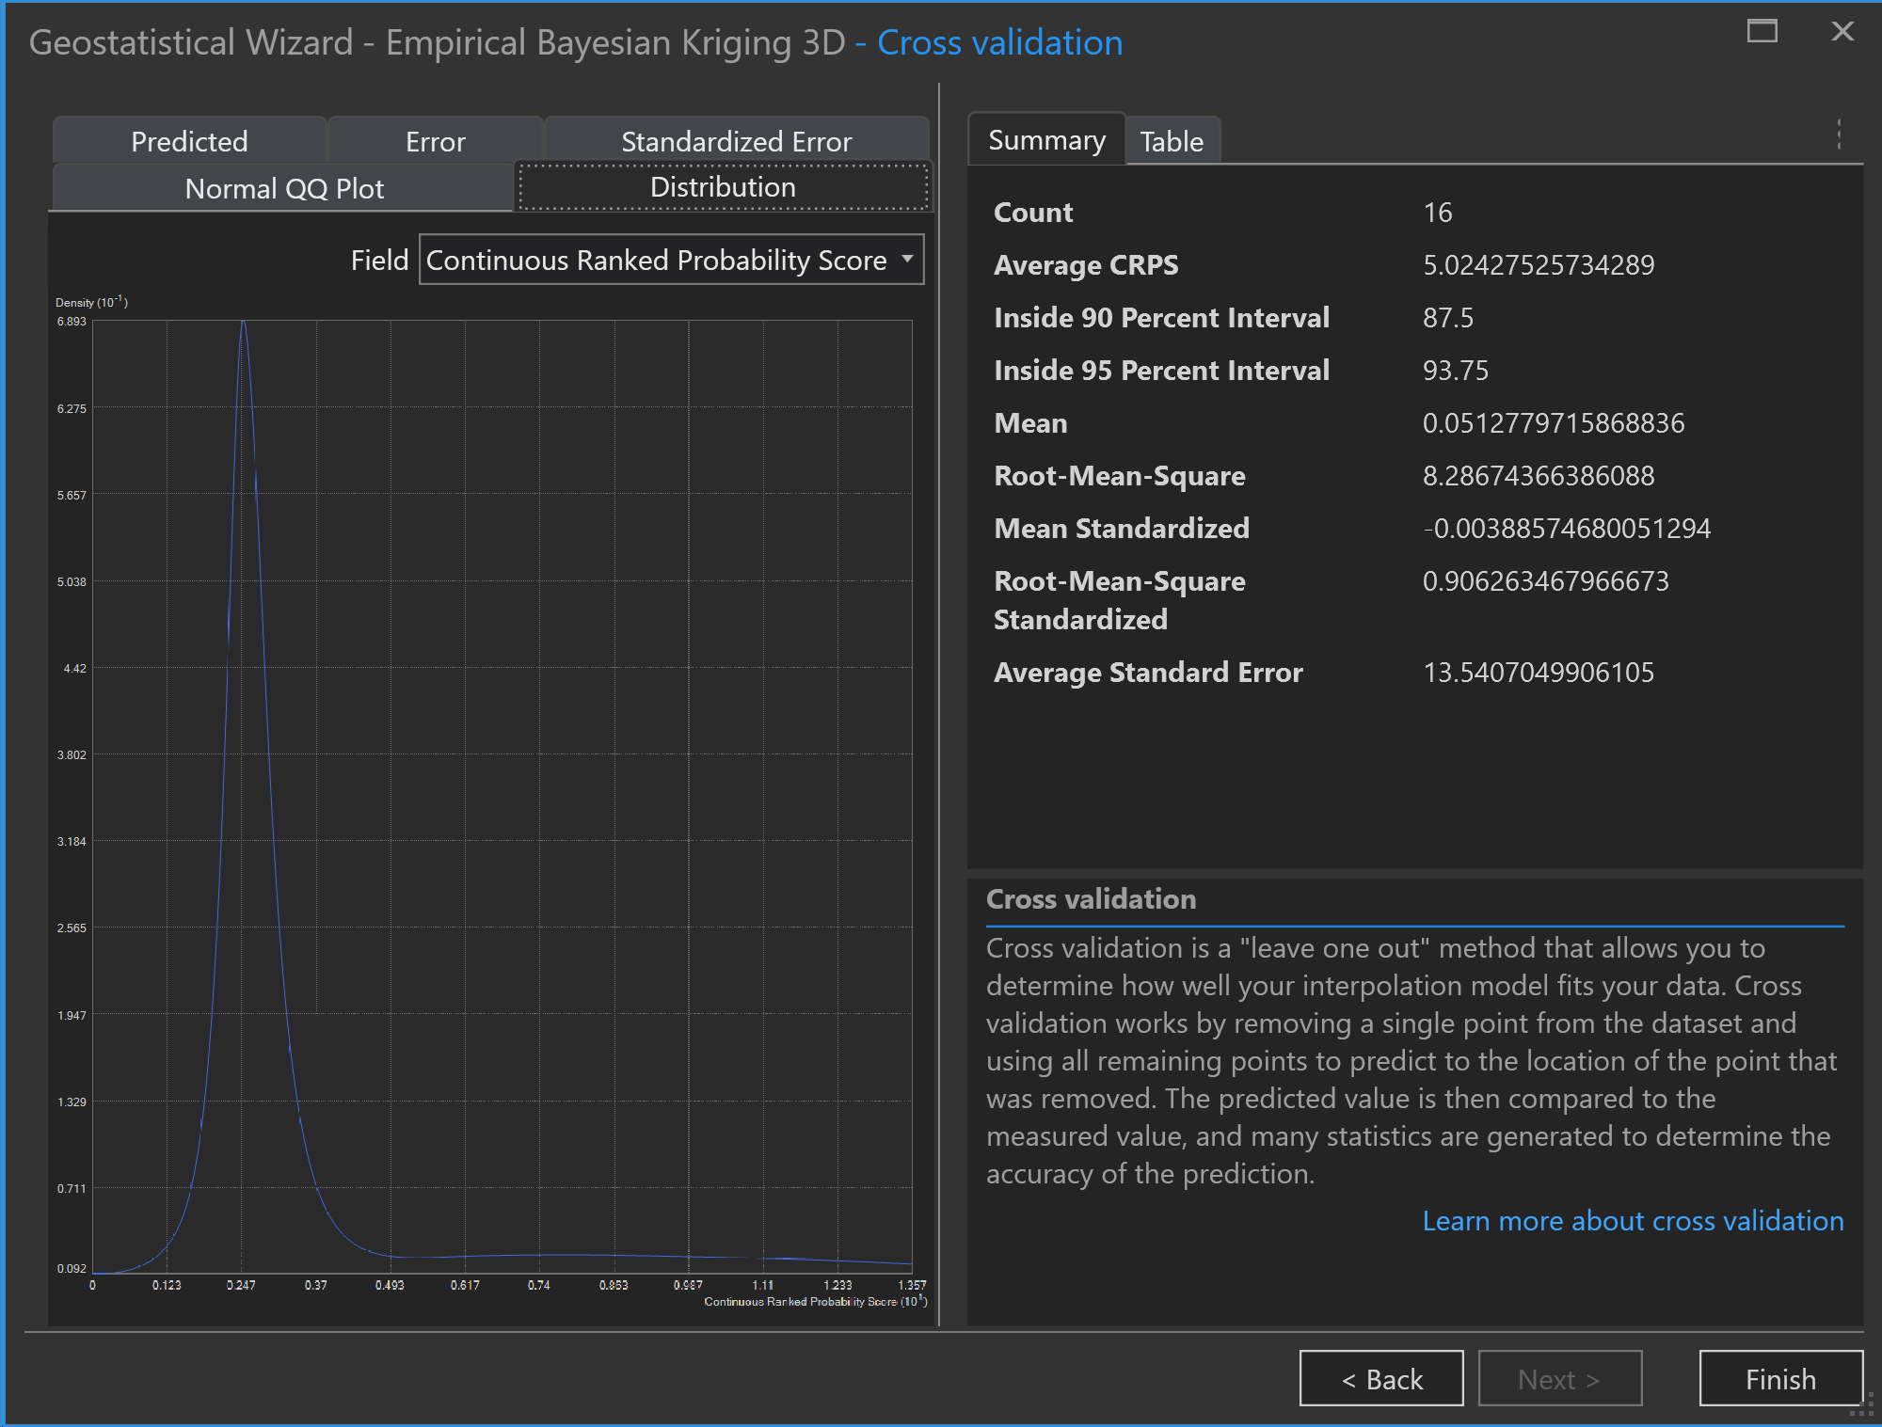

Slide 11
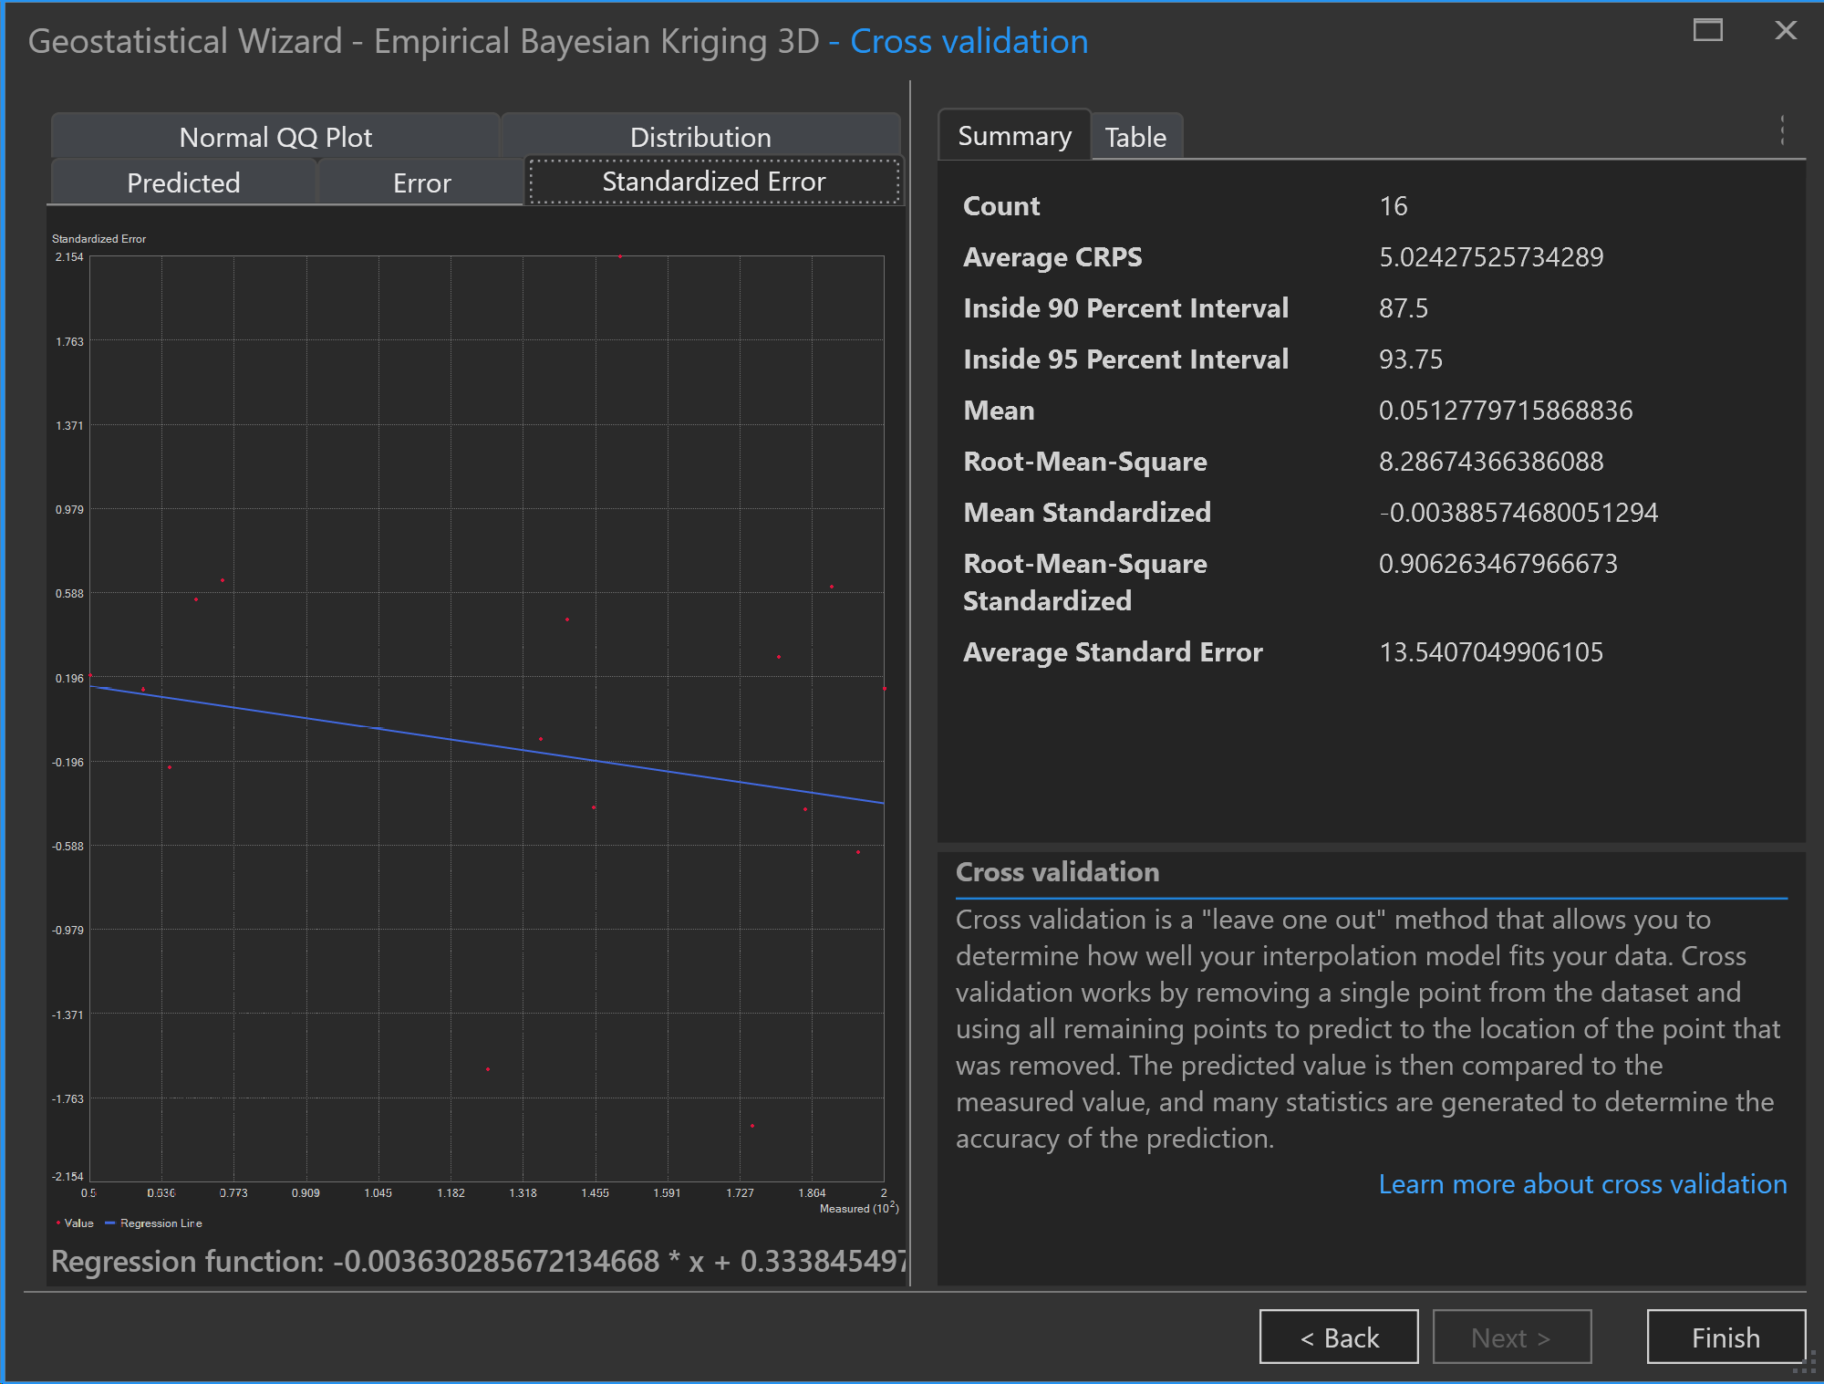

Slide 12
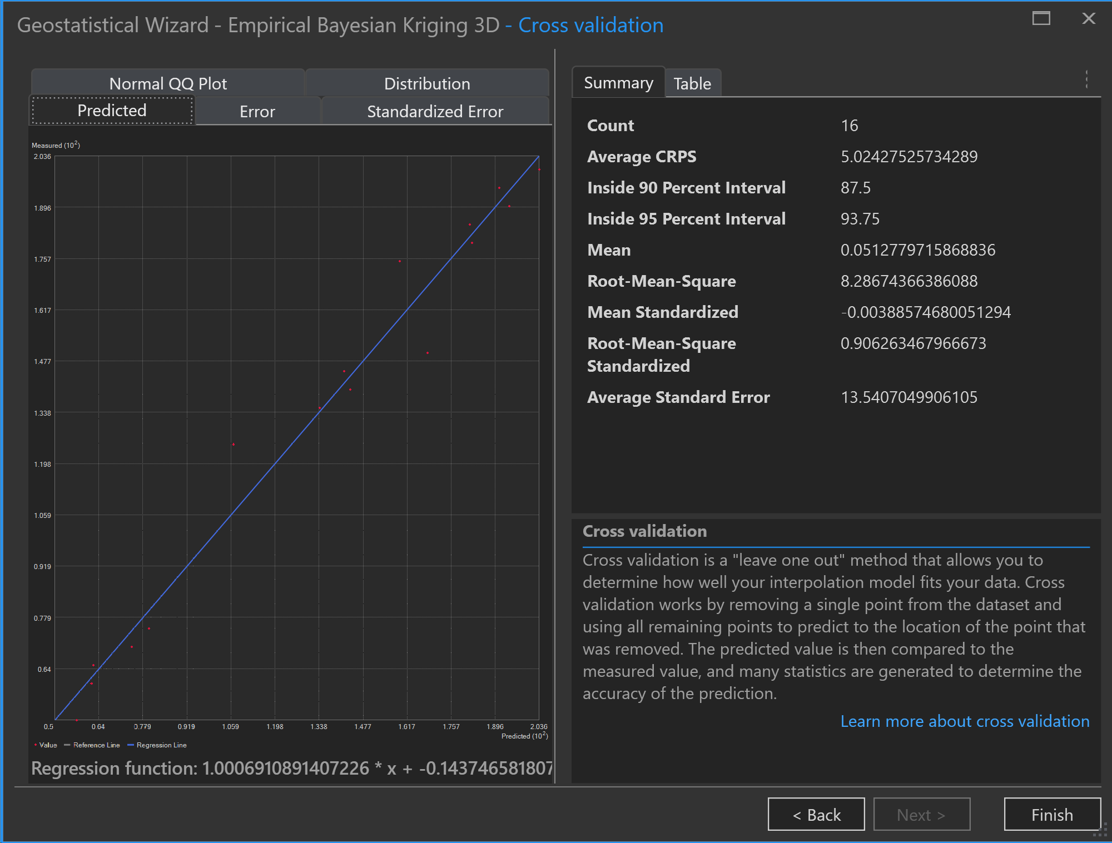

Slide 13
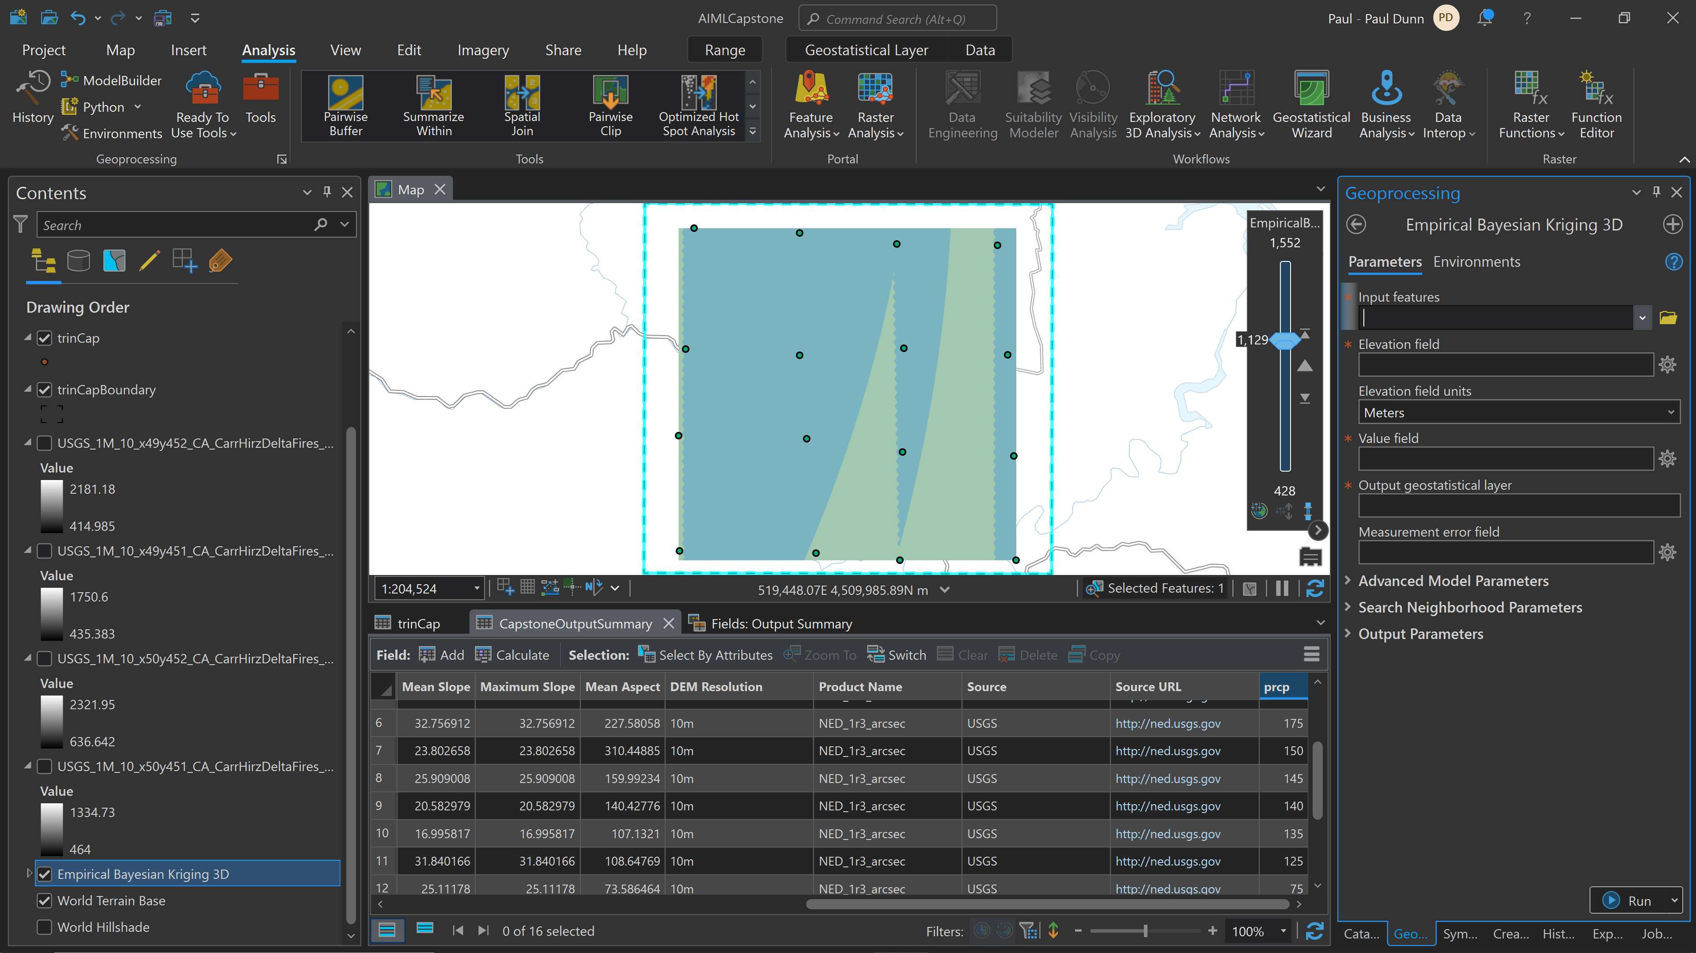

Slide 14
